Slide 1
Practical Use Cases for DAX Calculated Columns

Slide 2





Tristan Malherbe
Co-Founder Data Pulse
Consulting & Training on Power BI & Fabric
Microsoft Data Platform MVP
Power Query/M, Modelling, DAX, Data Visualisation
Tristan Malherbe
Co-Founder Club Power BI & Club Fabric
@Datatouille
French Power BI User Group: 7k members
Club Fabric: 300 members
Tristan Malherbe

Slide 3
Agenda
I – A bit of context…
II – Why DAX Calculated Columns can be bad ?
III – Use Cases for DAX Calculated Columns
Static segmentation based on DAX measures
Precomputing flags in Dimension tables
Inter-Table & Inter-Row (windowing) patterns

Slide 4
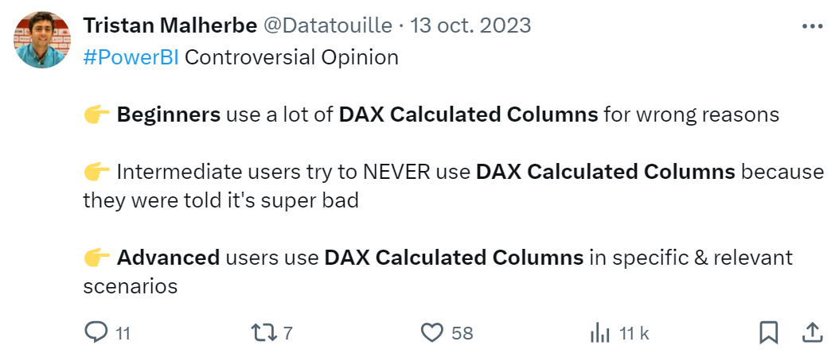
Context

Slide 5
Why DAX Calculated Columns can be bad ?
1) « Persisted » in the data model and only recompute at processing time
2) Can have a negative impact on Data Model processing time and size
3) Very often used for wrong reasons
What are the alternatives to create columns in a Power BI project ?
«Data should be transformed as far upstream as possible, and as far downstream as necessary» (Matthew Roche)
- DataWarehouse / SQL Layer: Not always available.
- Power Query / M: Not always easy nor performant. DAX is sometimes better.

Slide 6
The « Magic Triangle »
Front-End Performance
Front-End Performance: Performance & Interactivity of your Power BI Report. Mostly relies on the quality of your Data Model and DAX measures.
Back-End Performance: Processing time of your Power BI model. Relies on many factors: Data Volumes, Architecture & Infrastructure, Performance of the data source.
Data Model Size: Size of your Power BI model. Mostly Relies on: Data Volumes & Cardinality of Columns.
Data Model Size
Back-End Performance
Decisions that you make in Power BI

Slide 7
Conclusion
1) Do it upstream if you can (SQL / DataWarehouse) but be pragmatic
2) Always think about the ‘Magic Triangle’ when making decisions in your Data Model
3) DAX Calculated Columns can be a great weapon since they can leverage your Data Model
4) DAX Calculated Columns are easier to code / faster to execute than Power Query/M for inter-table and inter-row calculations (windowing).
5) DAX Calculated Columns can be also used as a temporary & short-term solution to test & learn. Then you can express your need to IT & Data Engineers so they do it upstream.

